Slide 1
Constructivism - early environment/context for interaction
Notes:
I wanted to cover at least one of the slides I did not get to last week. I thought about the important role of constructivism on the history of art and technology and thought it would be an interesting to explore it with regards to interactivity.

Slide 2
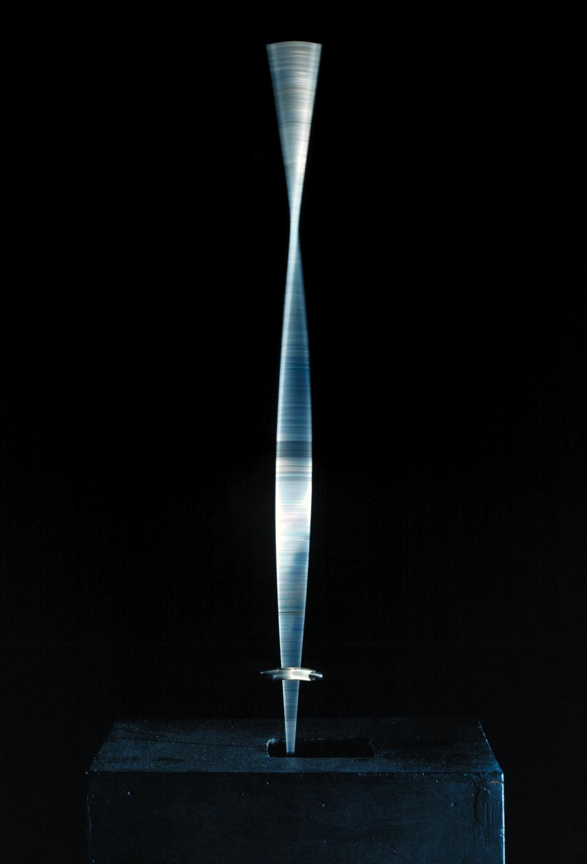
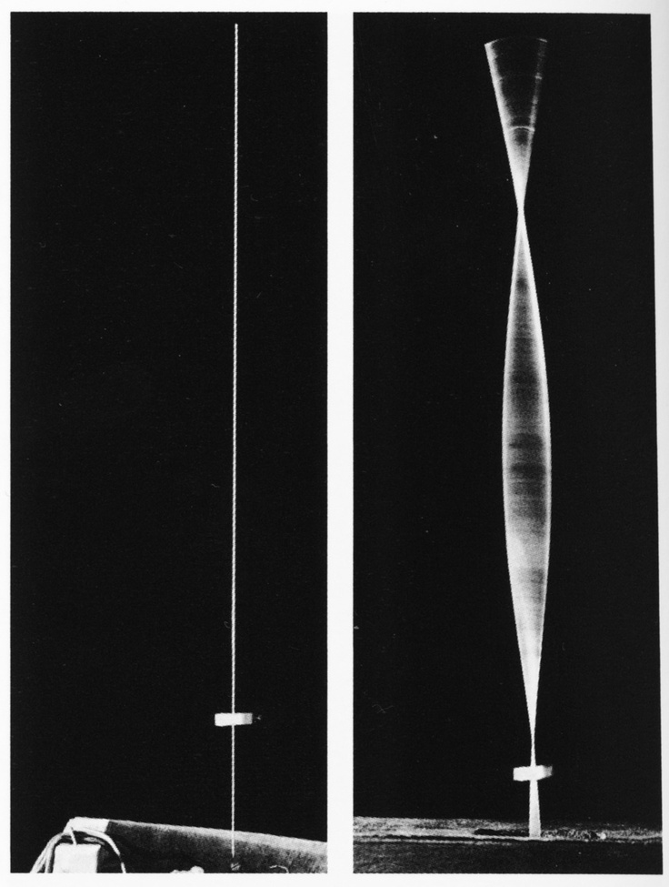
Realistic Manifesto, 1920
Naum Gabo and (brother) Antoine Pevsner
Art should be with people…
“at the workbench, at the office, at work,
at rest, and at leisure; work days and holidays,
at home and on the road, so that the flame of
life does not go out in man.”
- Realistic Manifesto
Naum Gabo, Kinetic Construction (Standing Wave), 1919-20

Slide 3
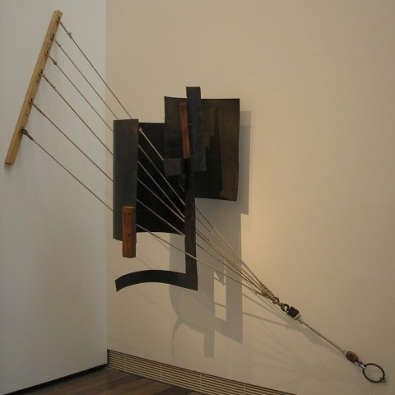
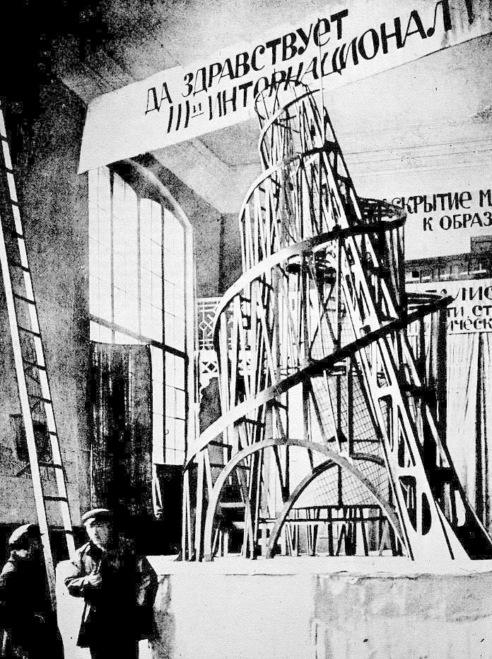
Tatlin, Monument to the Third International
1920
(Proposed) iron, steel and glass
Vladimir Tatlin, Corner Counter-Relief, 1914
Sheet metal, copper, wood, and metal attachments
Work was allowed to be touched

Slide 4
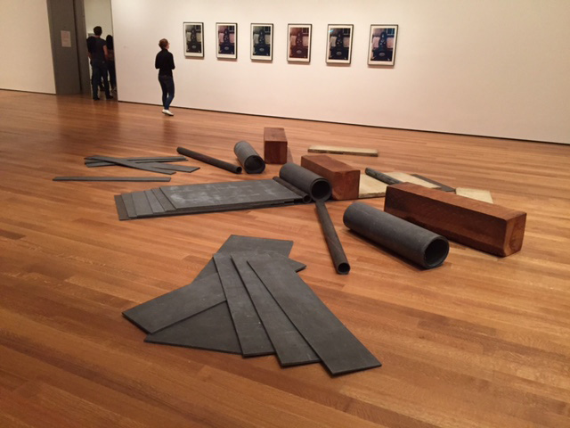
As Serra always says, the
interaction of the viewer is
critically important to this work
- creates its “meaning,” its entire
reason for being.
Minimalism was influenced by
Constructivism but how it is
different from Constructivism?
Richard Serra, Cutting Device: Base Plate Measure, 1969
Lead, wood, stone and steel

Slide 5
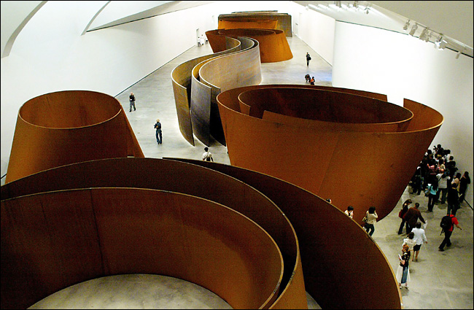
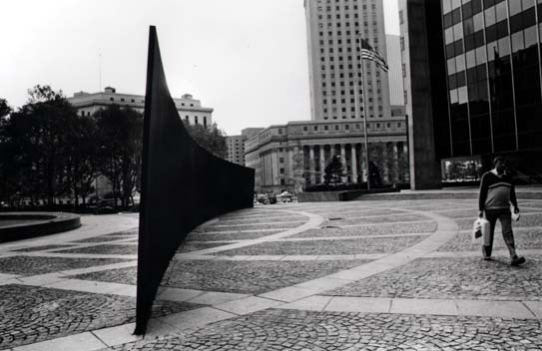
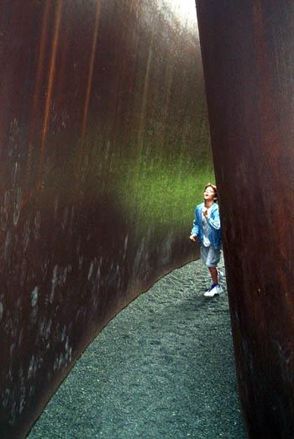
Serra, Matter of Time, Bilbao, 2003-05
“What interests me is the
opportunity for all of us
to become something
different from what we
are, by constructing spaces
that contribute something
to the experience of who
we are.” – Richard Serra
Serra, Tilted Arc, 1981 (dismantled 1989)
Corten steel
Foley Federal Plaza, NYC
120 feet long, 12 feet high
Serra, My Curves Are Not Mad, 1987
Nasher Sculpture Garden, Dallas

Slide 6
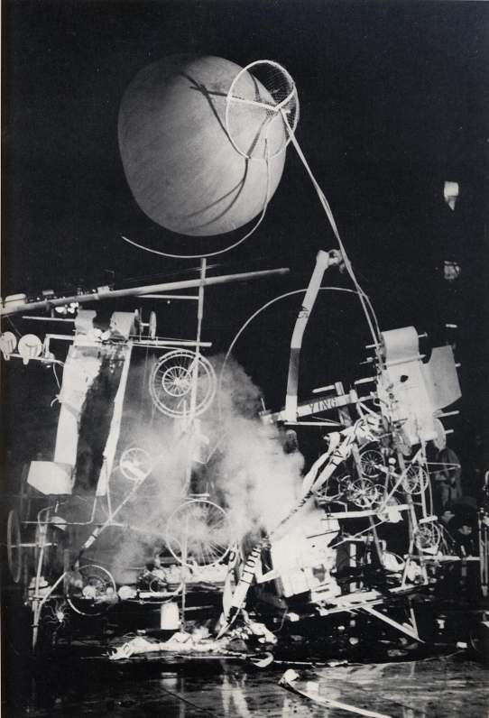
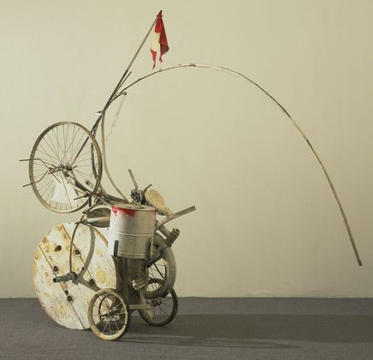
Jean Tinguely and Billy Kluver, Homage to New York, 1960
MoMA Garden
“Auto-destructive” work of art
The term “kinetic art” was first used in Gabo’s Realistic Manifesto;
Later used by Laszlo Moholy-Nagy. Tinguely was inspired by Gabo
and Tatlin, as well as Dada.

Slide 7
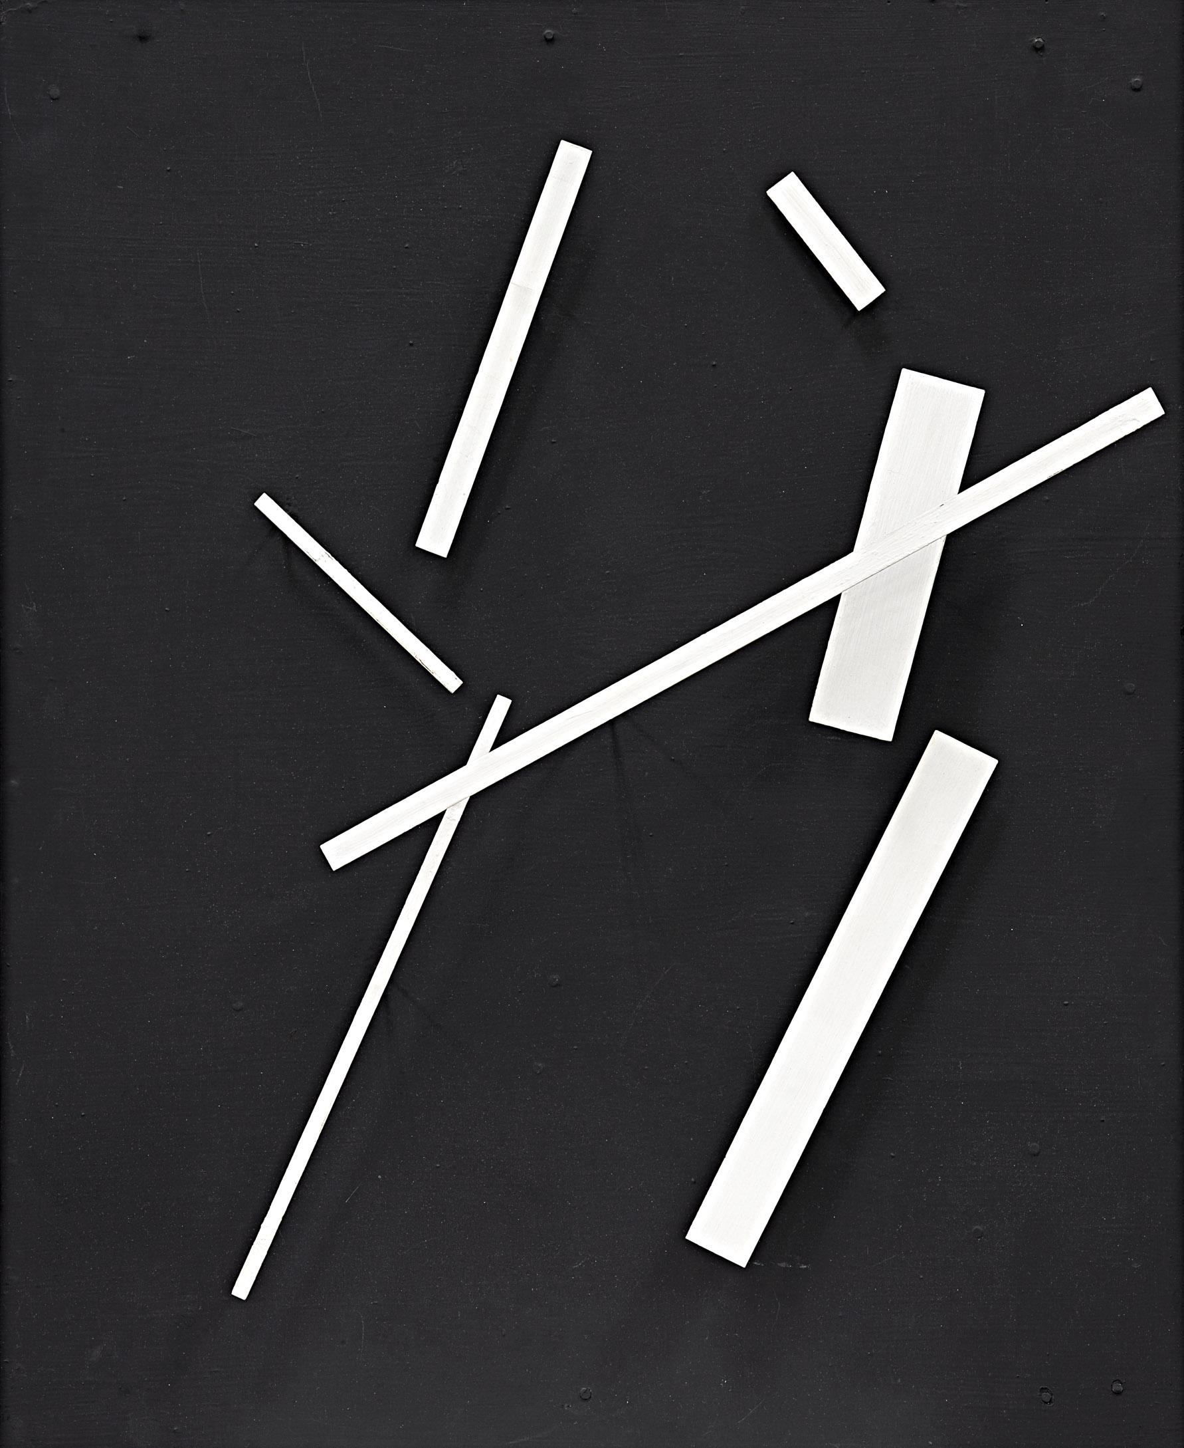
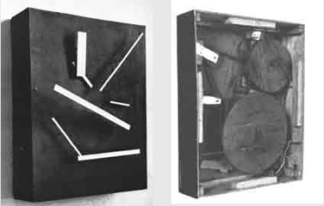
Jean Tinguely, Meta-Malevich, 1954
Wooden box, paint, electric motor, pulleys, rubber belts and metal

Slide 8
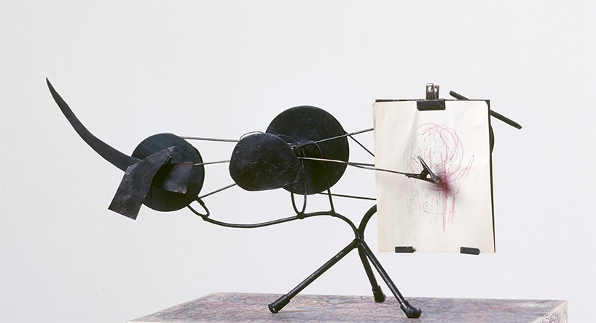
Tinguely “metamatic”

Slide 9
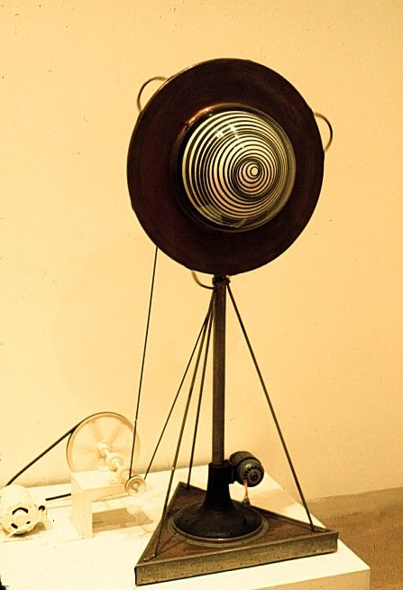
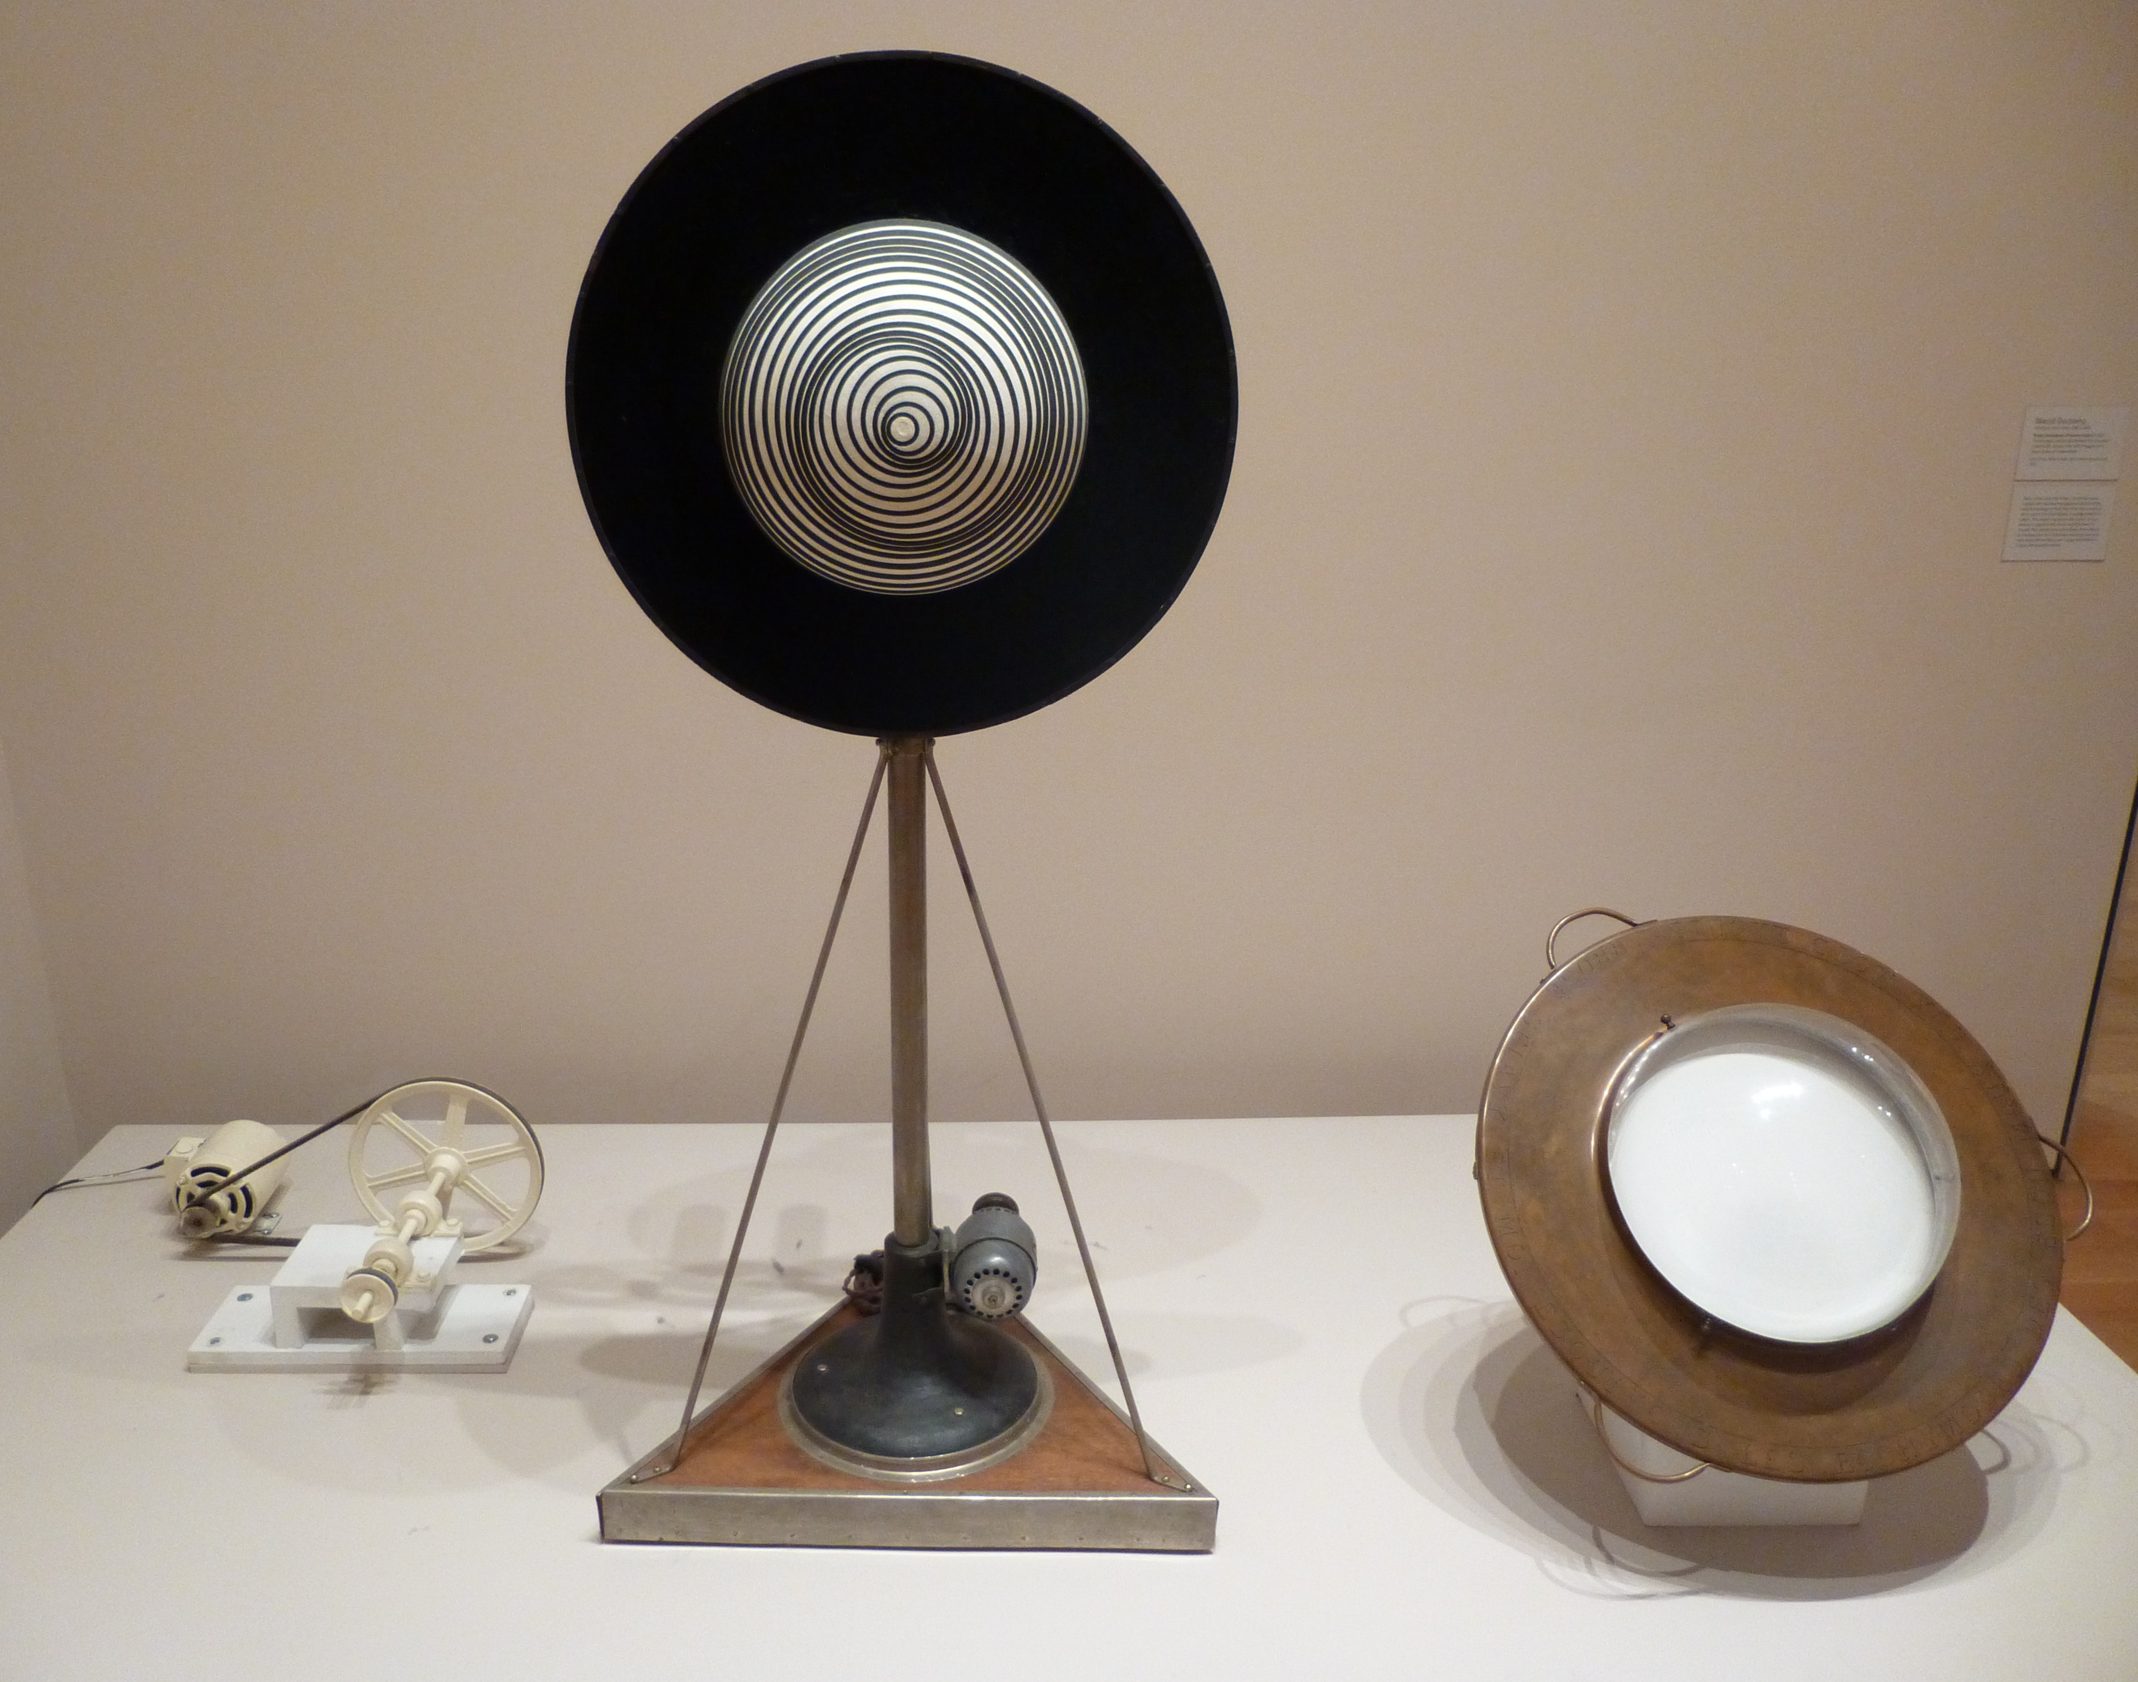
Marcel Duchamp, Rotary Demisphere (Precision Optics), 1925
Painted papier-mâché demisphere fitted on velvet-covered disk,
copper collar with plexiglass dome, motor, pulley, and metal stand
Notes:
Exhibited at Le Mouvement, Galerie Denise Rene, Paris, 1955.

Slide 10
“All in all, the creative act is not performed by the artist alone; the spectator brings the work
in contact with the external world by deciphering and interpreting its inner qualifications
and thus adds his contribution to the creative act.” - Marcel Duchamp, “The Creative Act,” 1957
Whole text, and reading of text by Duchamp, on UbuWeb

Slide 11
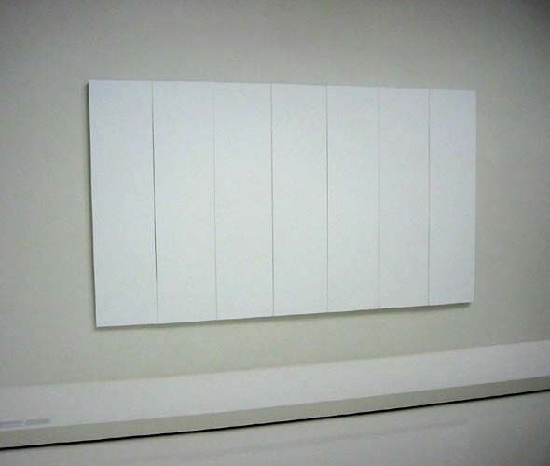
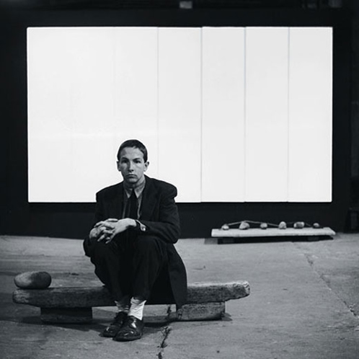
Robert Rauschenberg, White Painting, 1951
Oil on canvas

Slide 12
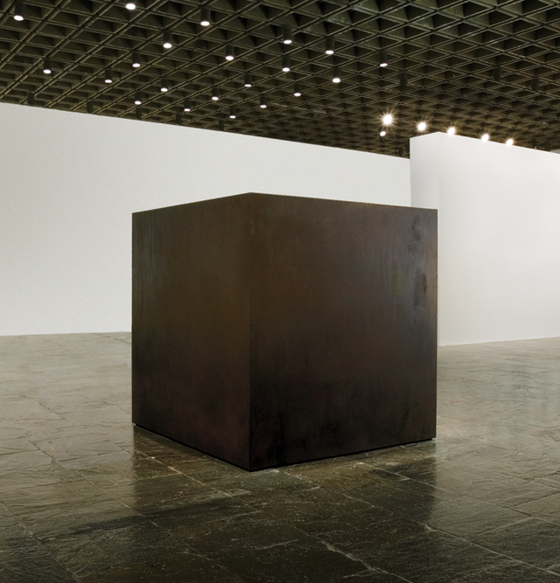
Tony Smith, Die, 1962
Steel

Slide 13
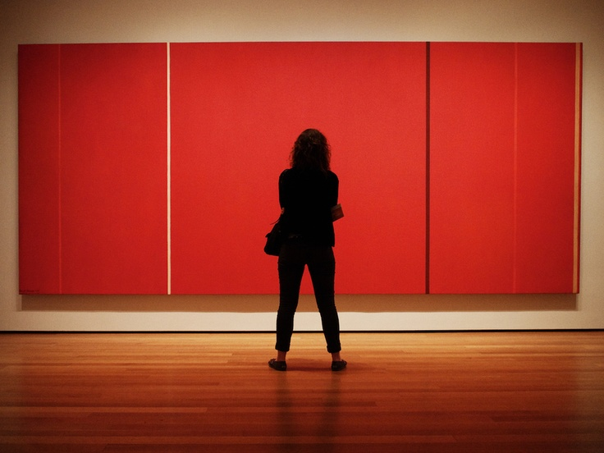
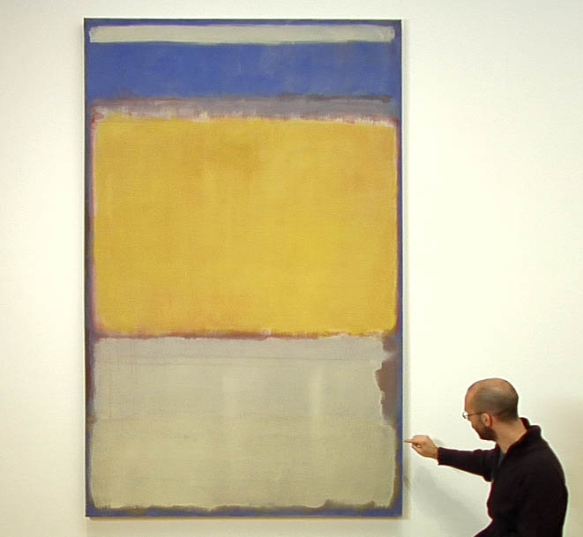
Barnett Newman, Vir Heroicus Sublimis, 1950
Oil on canvas
Mark Rothko, No. 10, 1950
Oil on canvas

Slide 14
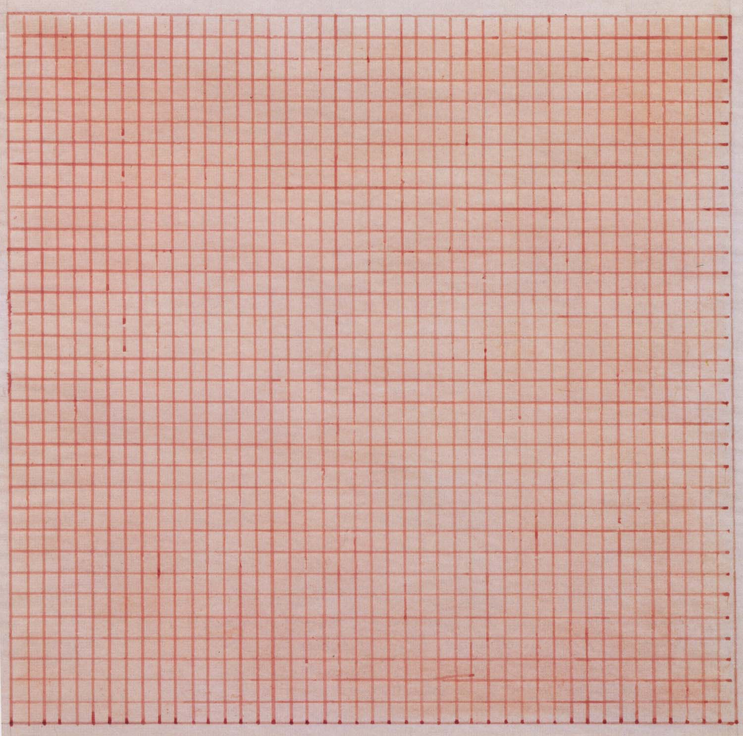
Agnes Martin, Untitled, 1963
Red pencil on canvas

Slide 15
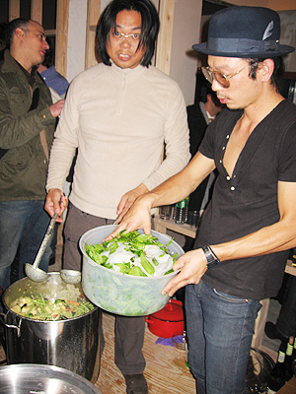
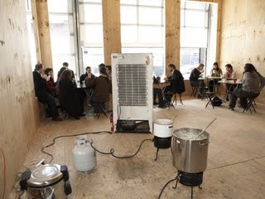
Involvement of the audience is the main focus of his
work; the food is but a means to allow a convivial
relationship between audience and artist to develop.
Open-ended, laboratory exhibitions. Tiravanija
provides the parameters but never dictates the
outcome.
Rirkrit Tiravanija, Thai Food, 1990s
Emphasis in his art on use rather than contemplation.

Slide 16
Nicolas Bourriaud, Relational Aesthetics
Summary derived from Claire Bishop, “Antagonism and Relational Aesthetics,” October, Fall 2004
Art of the 1990s focuses on the realm of human interactions and its social context and seeks to establish
intersubjective encounters in which meaning is elaborated collectively.
2. Rather than a discrete, portable, autonomous work of art that transcends its context, relational art is
entirely beholden to the contingencies of its environment and audience.
3. Rather than a one-to-one relationship between work of art and viewer, relational art sets up situations in
which viewers are not just addressed as a collective entity, but are actually given the agency to “conduct” works
of art as a community.

Slide 17
4. Relational art is seen as a direct response to the shift from a goods to a service-based economy.
5. Relational art is seen as a response to the virtual relationships of the internet and globalization, which
on the one hand have prompted a desire for more physical and face-to-face interaction between people, while
on the other have inspired artists to adopt a DIY approach and model their own universes.
The main difference between the art of the 1990s and that of previous generations (the art of the 1960s,
for example) is a shift in attitude toward social change. Instead of a utopian agenda, today’s artists seek
to address the here and now, “learning to inhabit the world in a better way.” As Bourriaud states: “It
seems more pressing to invent possible relations with our neighbors in the present than to bet on happier
Utopias.”

Slide 18
Social Practice
Carolina Miranda, assigned reading, discuss
Critique: Chin, Fundred project (2006, ongoing): original intent and current website

Slide 19
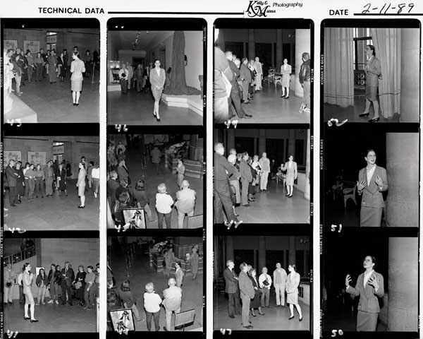
Andrea Fraser, Museum Highlights: A Gallery Talk,
Philadelphia Museum of Art, 1989

Slide 20
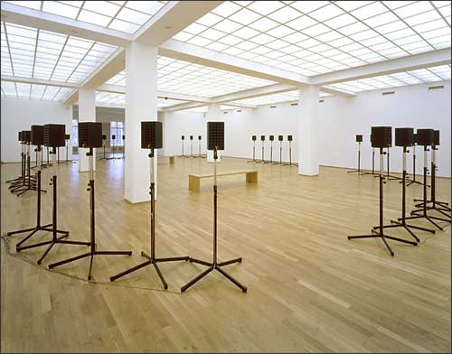
Janet Cardiff, Forty-Part Motet, 2001
After Thomas Tallis, Spem in Alium (Hope in Any Other), c16
Composed for 8 choirs of 5 voices each

Slide 21
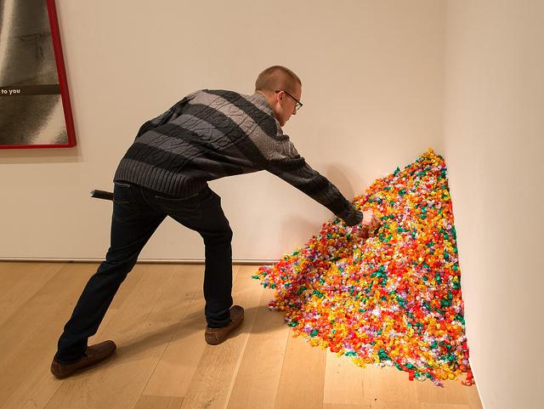
Felix Gonzalez-Torres, Untitled (Portrait of Ross), 1991

Slide 22
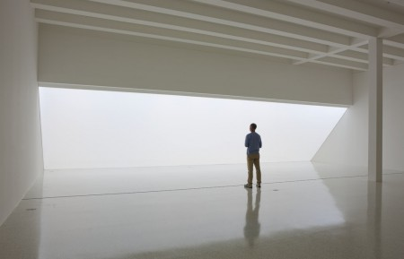
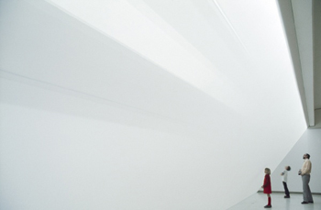
Robert Irwin, Untitled, 1971
Synthetic fabric (scrim), wood, fluorescent lights, flood lights
Walker Art Center

Slide 23
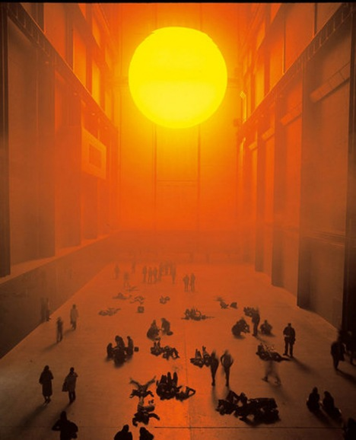
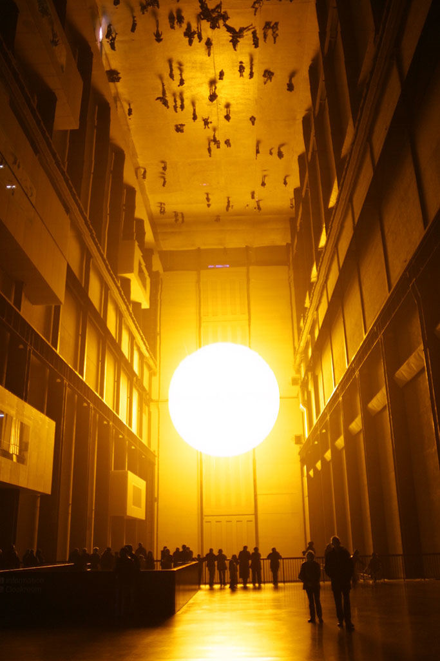
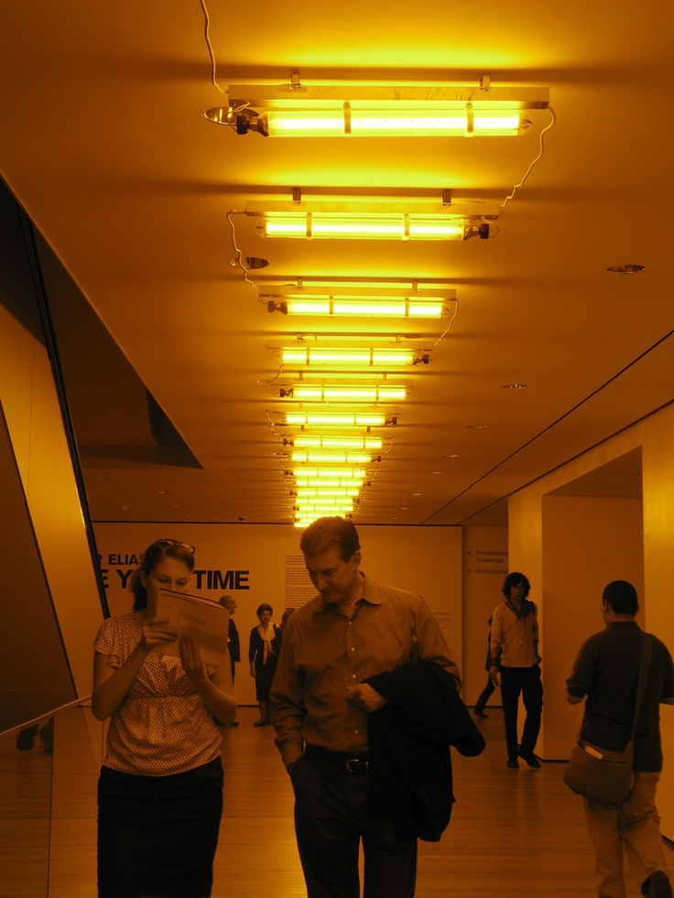
Eliasson, The Weather Project, 2003
Tate Modern, Turbine hall
Screen back-lit by 200 yellow, mono-frequency
lamps mounted 8 meters from end of wall
Olafur Eliasson, MoMA, 2008

